Slide 1

Analysis of Chicago E-Scooter Pilot Program
Charlie Marshall
Civ 495
11 June 2020

Slide 2
Contents:
Topic Introduction
Exploratory Data Analysis
Modeling
Conclusions

Slide 3
Introduction
According to National Household Travel Survey in 2009, 50 percent of all trips are 3 miles or less. However, 72 percent of these trips are driven.
Ridesharing and E-scooter enthusiasts believe that E-Scooters present an exciting way to travel short distances, decreasing road congestion
Pilot Program took place from June 15th to October 15th mainly within a clearly defined “pilot area” which was chosen because of diversity within the area

Slide 4
Data
E-Scooter Trips:
from Chicago Data Portal, 700k trips in 3 month period
Start/End time, Start/End Community Area, Start/End Census Tract, Distance, Duration
Chicago Community Area Data:
From two sources giving CCA profiles
Includes info such as income, race, transportation, housing, etc
Weather Data:
Hourly weatherly data for Chicago-land area

Slide 5
Data: Preprocessing
Trips:
Tips under 1 min and under a quarter mile were dropped. This is common procedure from other analysis of same data to reduce “cyclical trips”
Data Frame created for daily demand for e-scooters within each community area
Missing demand values were assumed that there were no trips (no demand) during that day
Training data = within pilot area
Testing data = outside pilot area

Slide 6
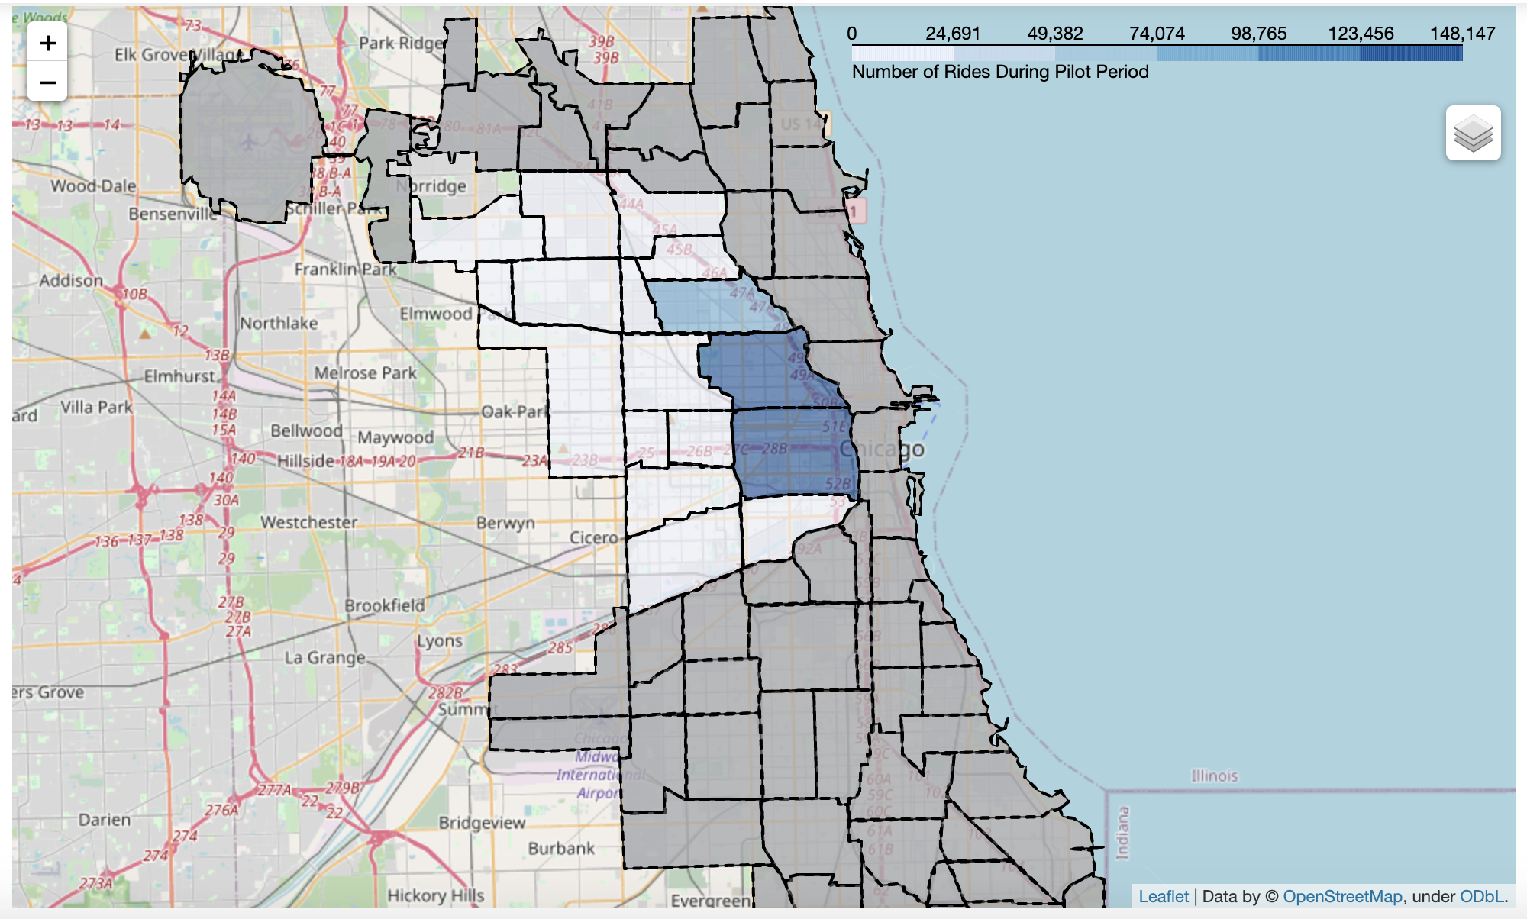
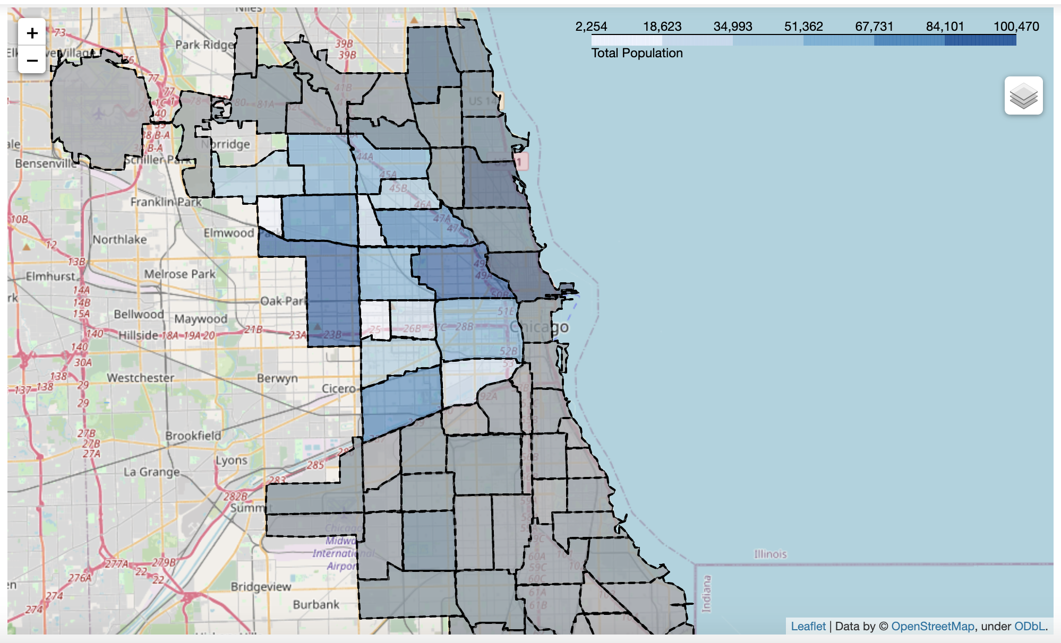
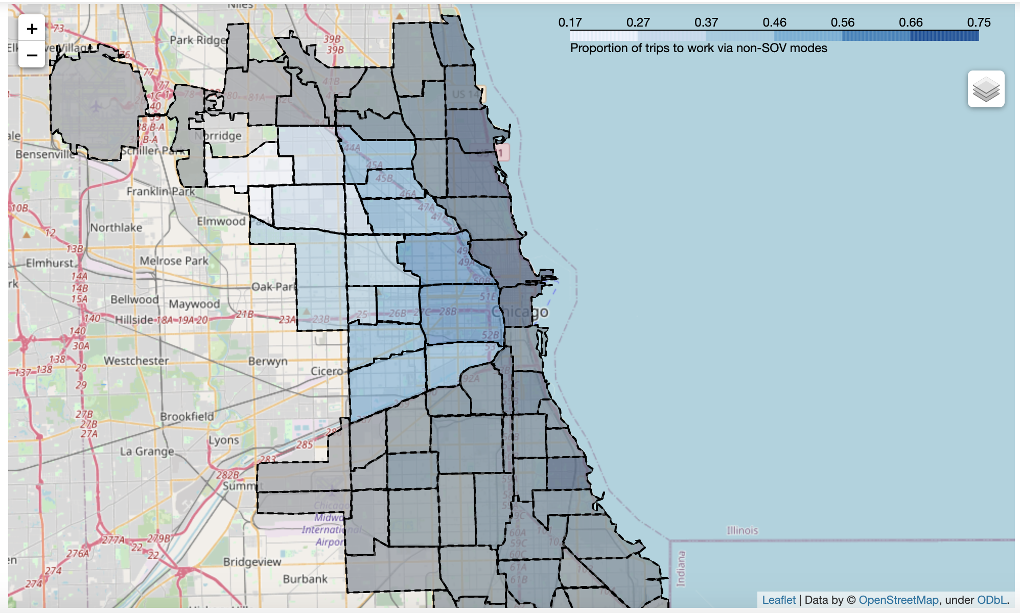
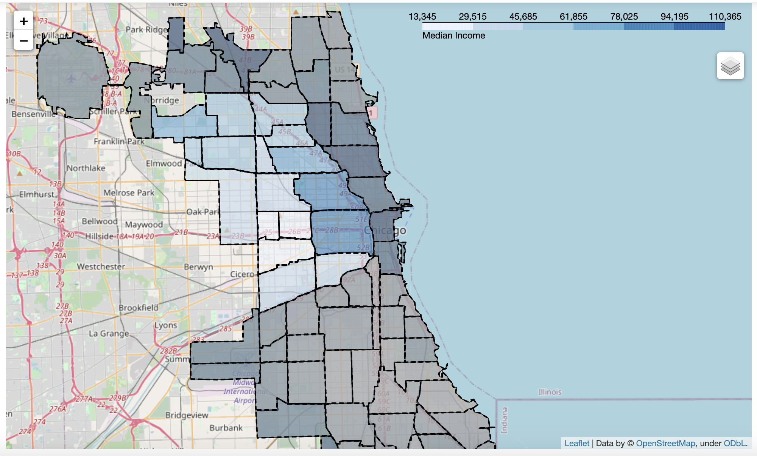
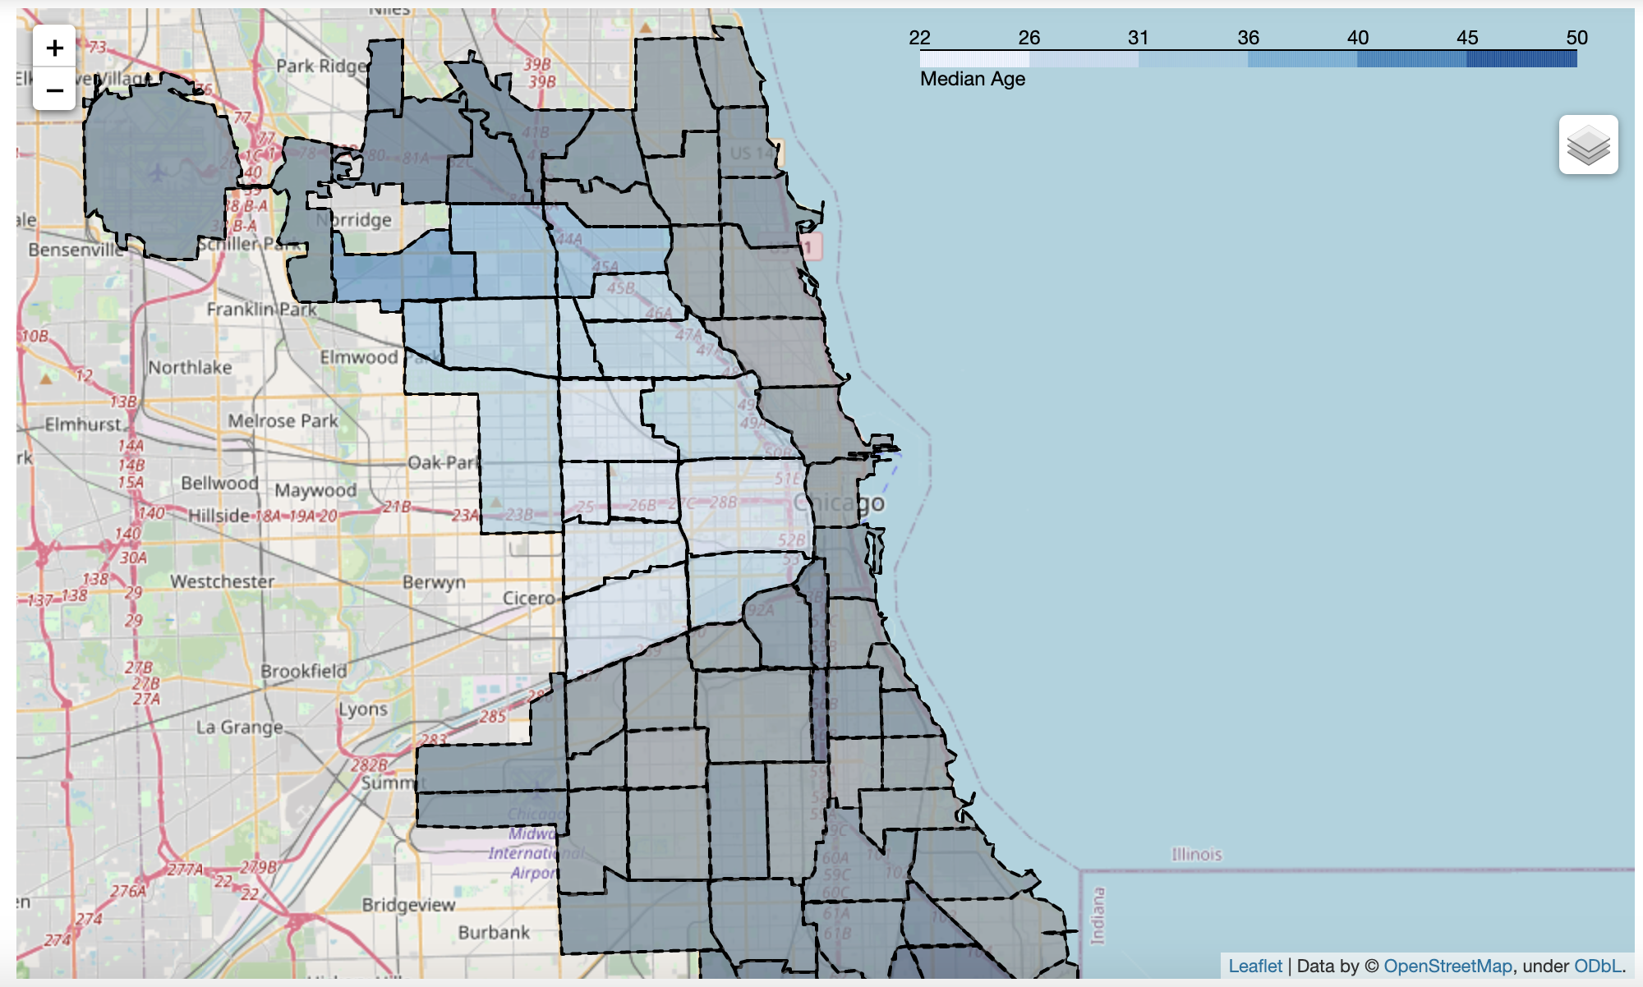
Exploratory Data Analysis: Community Areas

Slide 7
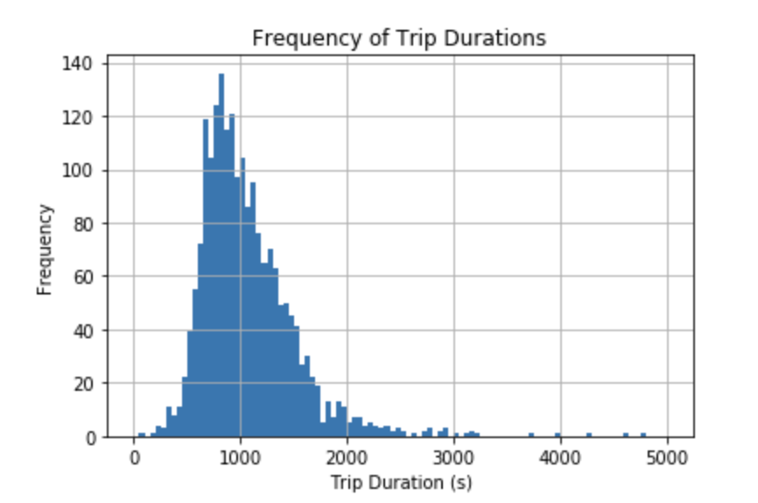
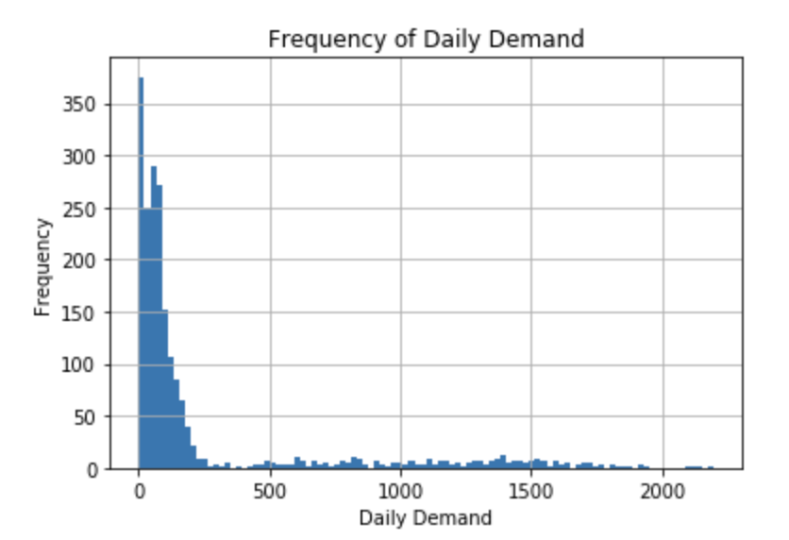
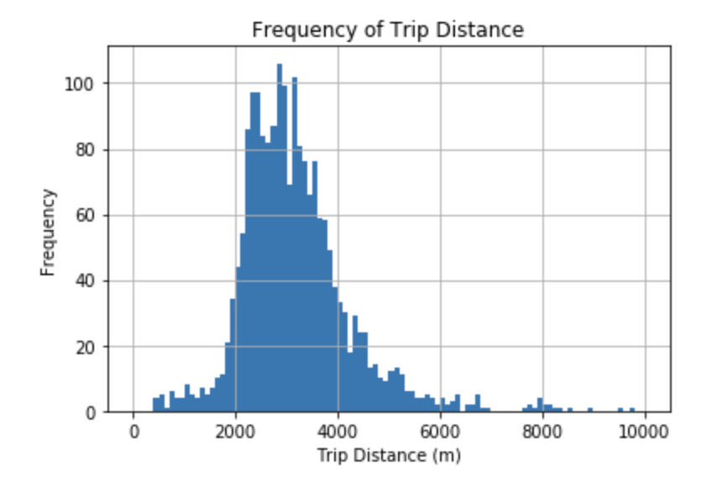
Exploratory Data Analysis: Aggregate Level

Slide 8
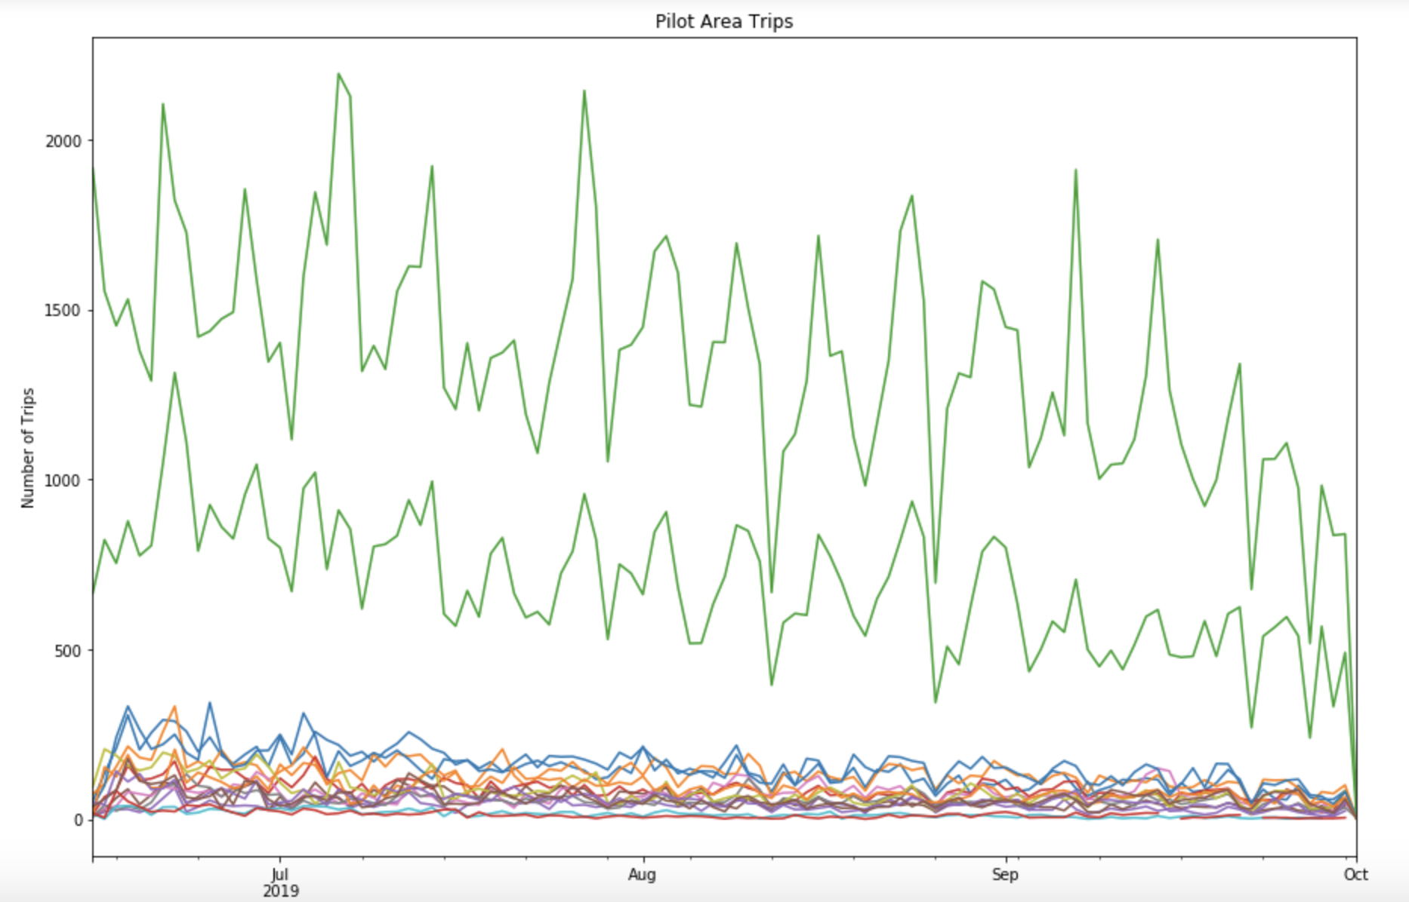
Exploratory Data Analysis: Time Series

Slide 9
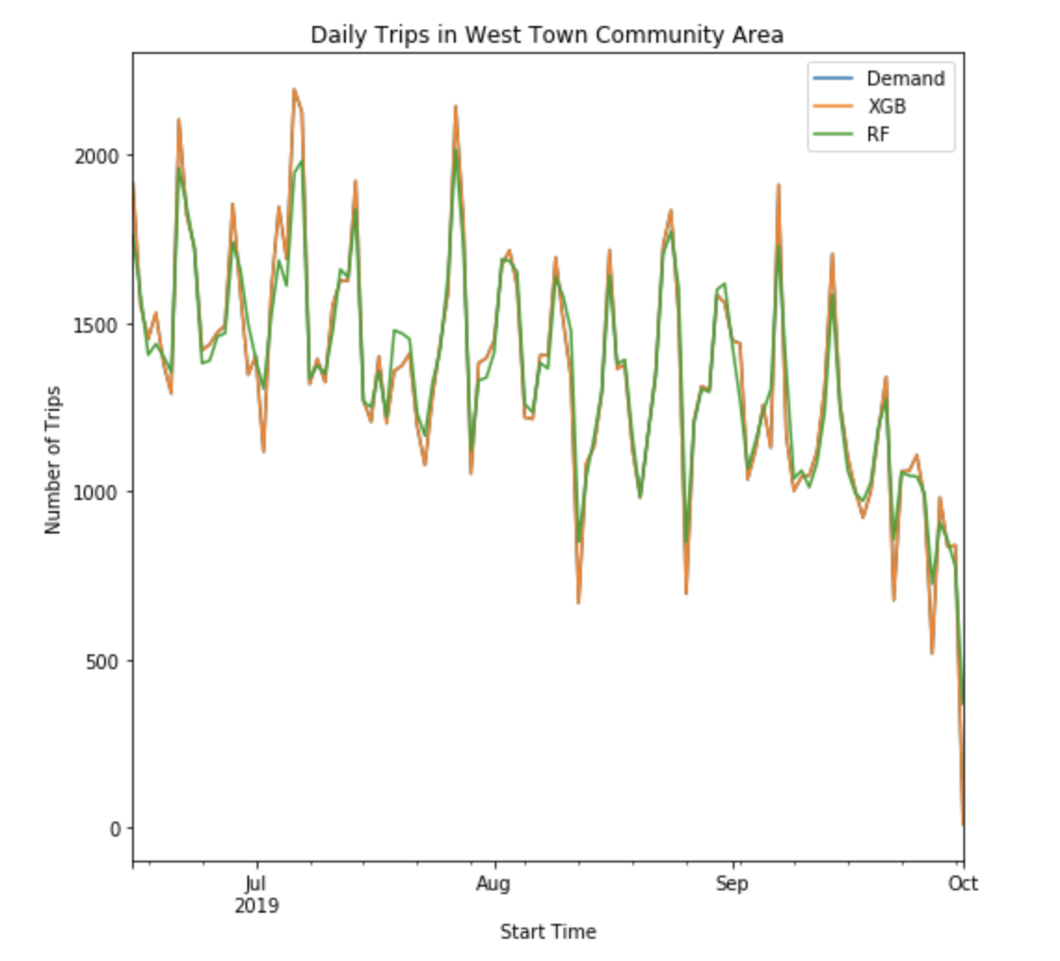
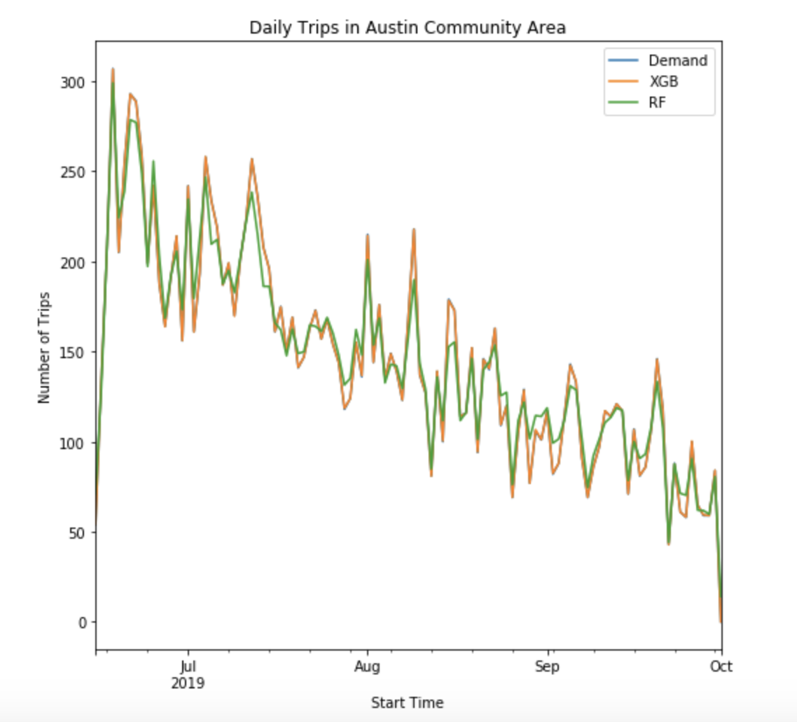
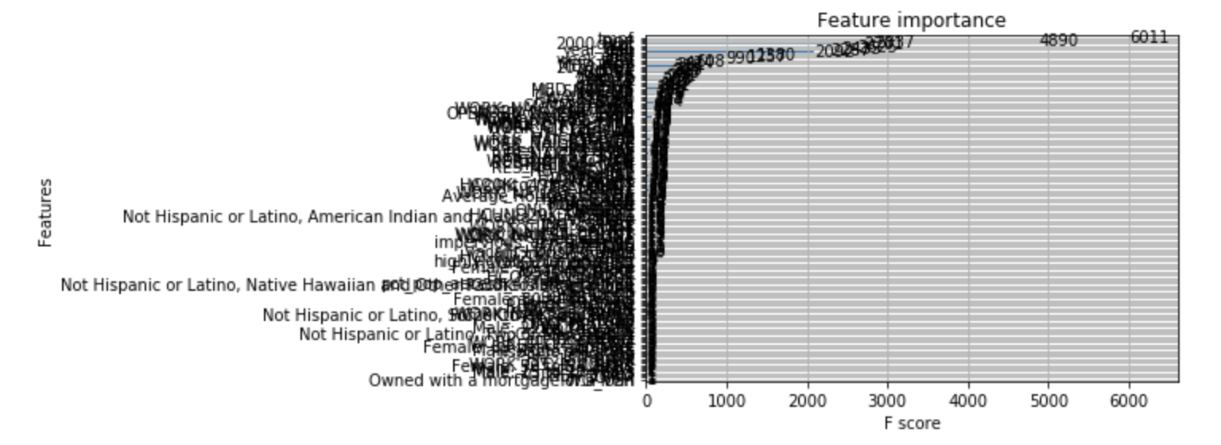
Modeling
Three different models used: LSTM, XGBoost, and RF
Training Metrics:
XGB: mse = 0.08, mae = 0.23
RF: mse = 708, mae = 11.3

Slide 10
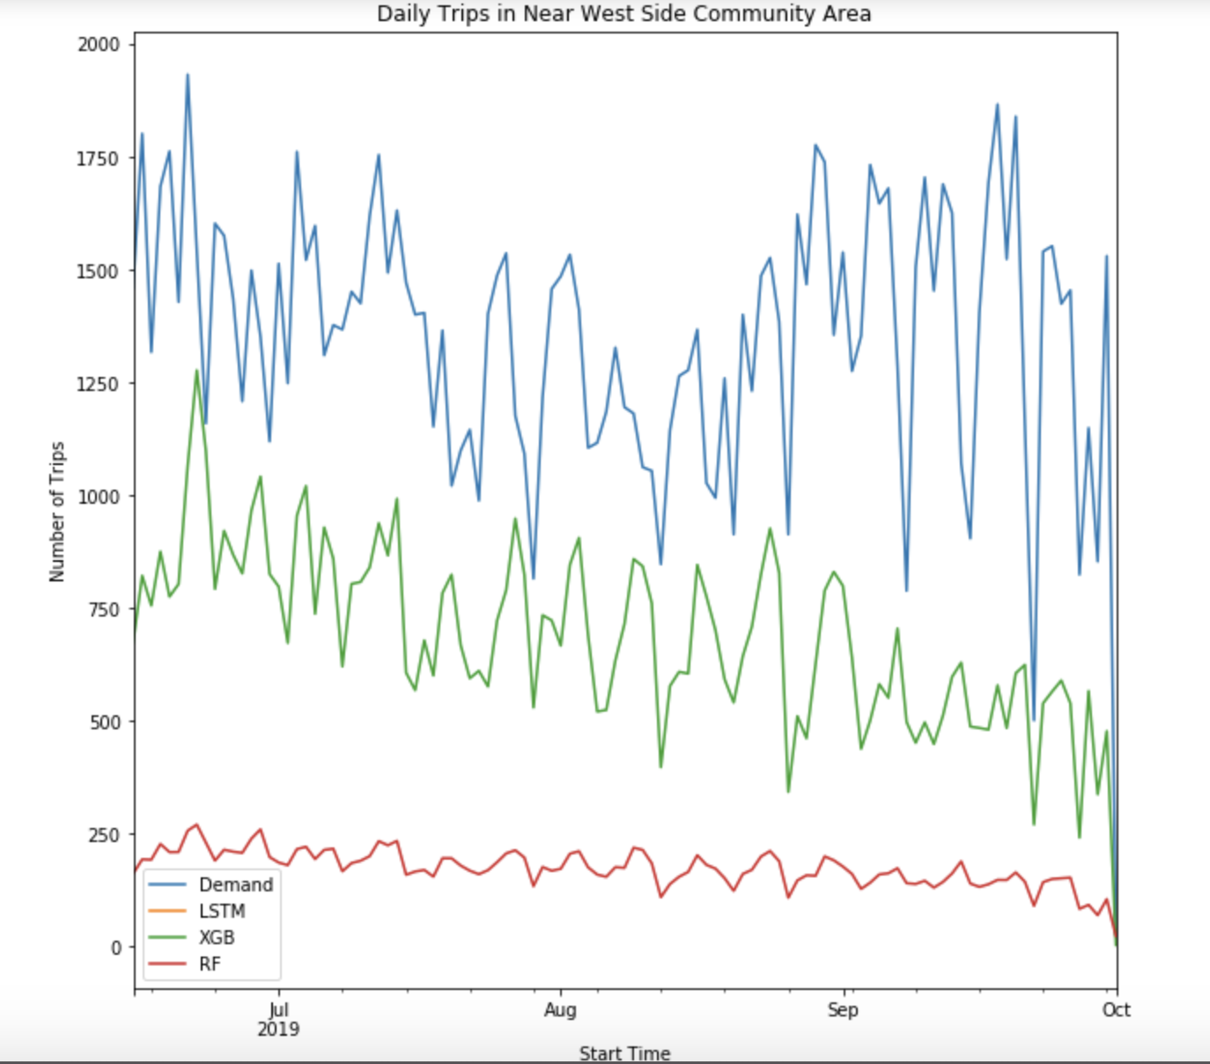
Testing Results

Slide 11
Conclusion/Takeaways:
Interesting Community areas:
Lake View, Near West Side, Near North Side, Lincoln Park
All these areas are mainly on north side
Takeaways:
Good at predicting when the peaks and valleys would be on new data, but not magnitude
Most areas have daily demand between 0-500 trips, good at predicting this\
Feature engineering: dropping unimportant features
Potential Future Work:
Improve forecasting in areas with higher demand
Forecasting for longer trips

